Slide 1



AI-Assisted Texturing for Unity Game Development

Slide 2


Artificial Intelligence is the Future
AI technology is rapidly improving
Part of everyday life
Widely used in creative industry:
Photoshop
Films/TV
Music
Gaming Industry?

Slide 3
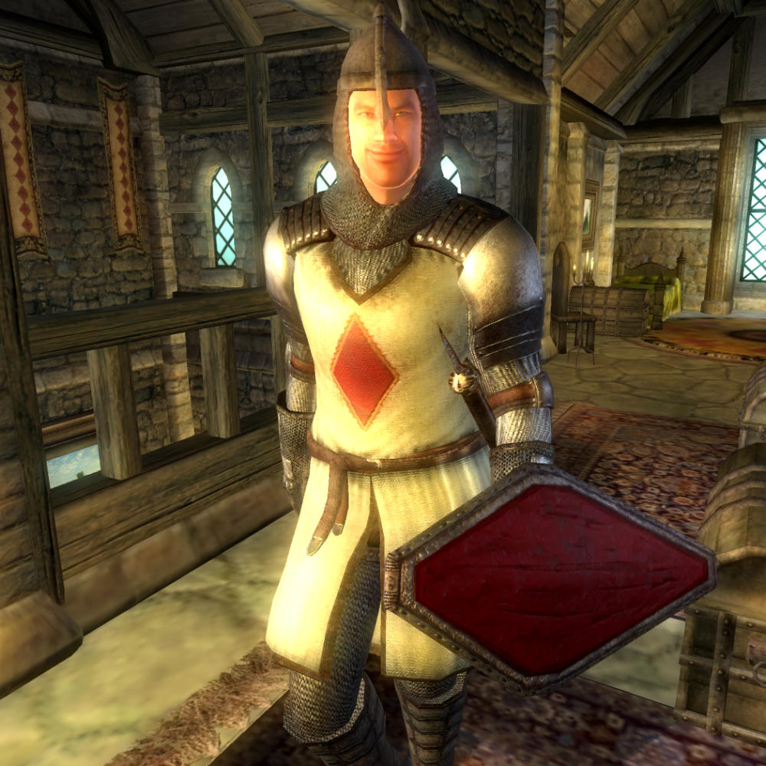
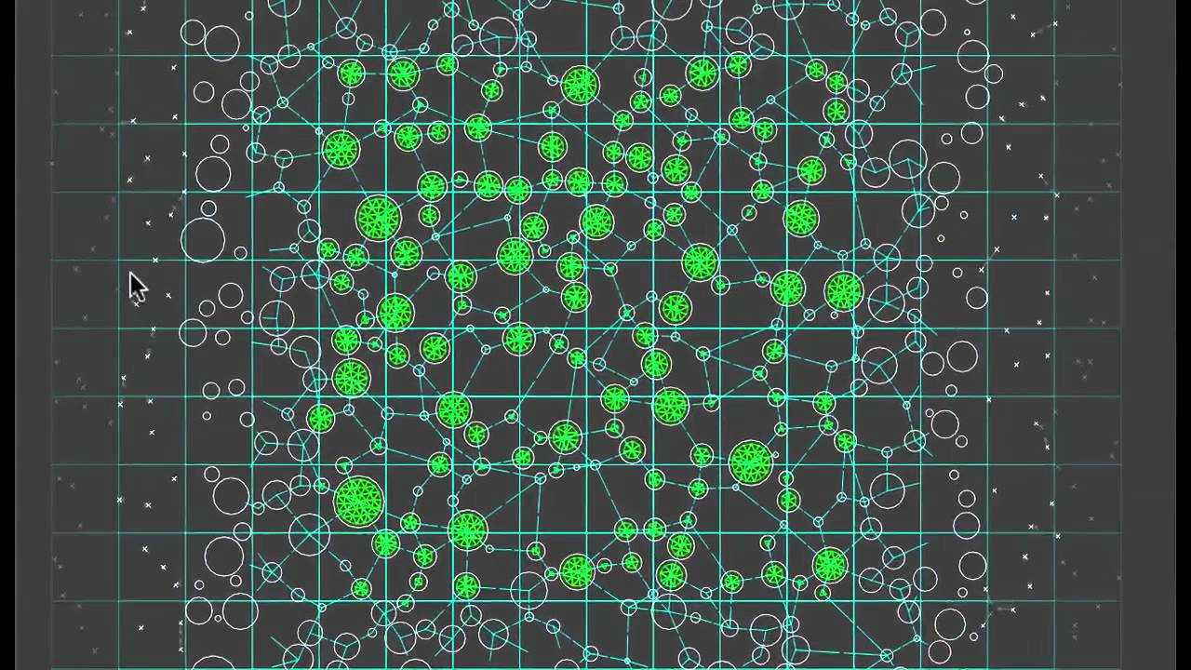
AI & Games
NPCs
Procedural Generation
Data Mining
Advanced Game Development Tools
Tools for new developers?
Textures?

Slide 4
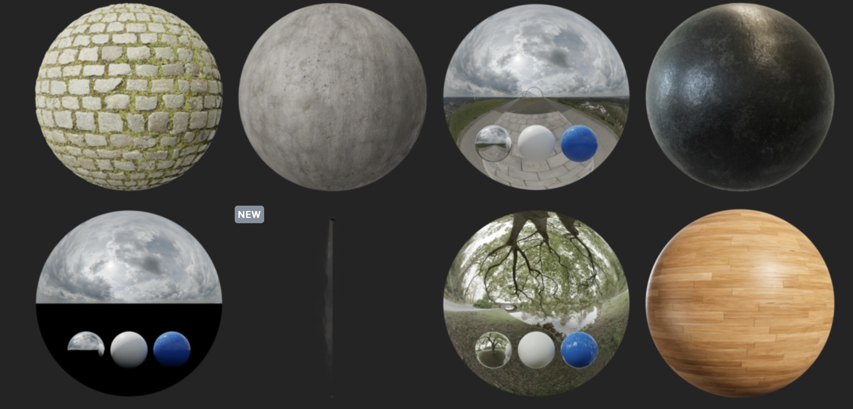
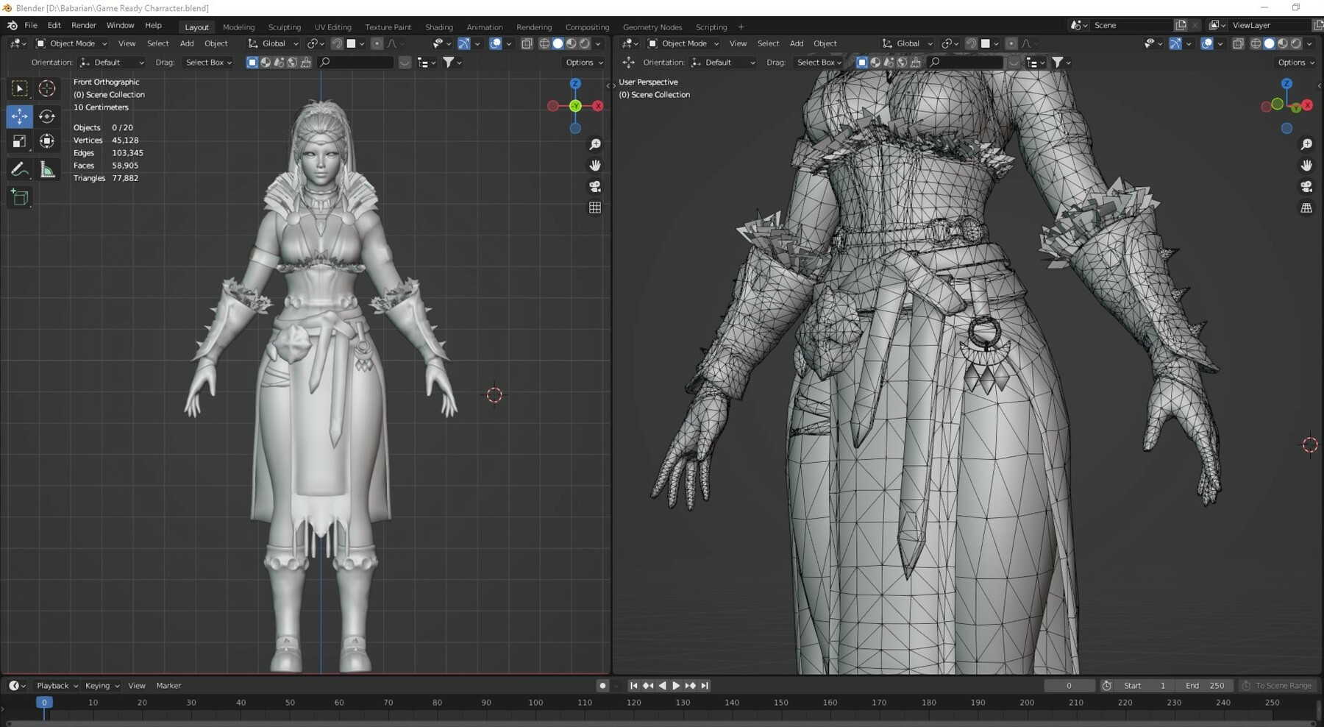
Texturing in Unity
2 methods
Find suitable textures online or on Unity Asset Store
OR
Create own (Blender)
Can AI help?

Slide 5
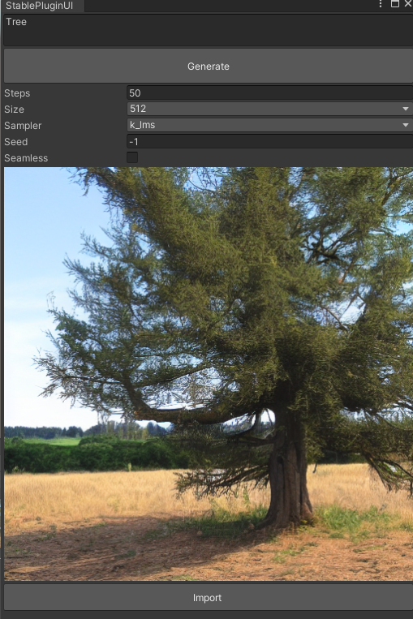
Outline of Project
Created a Unity Plugin
Uses Stable Diffusion to generate unique images from text-prompts
Users can modify output
Import to Unity

Slide 6
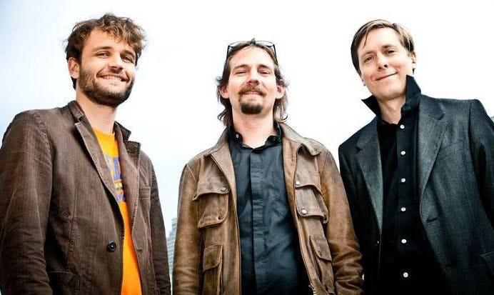
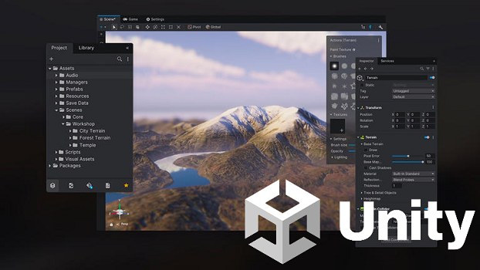
Background – What is Unity?
Game engine released in 2005
Can be used to make 2D and 3D games
Multi-platform
1.5 million active creators monthly
Most popular game engine for beginners and Indie developers
Easy to use interface with powerful functionality

Slide 7
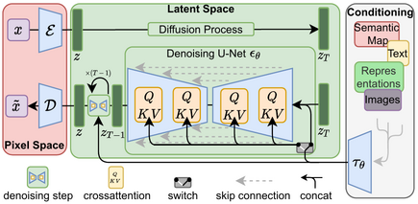
Background – What is Stable Diffusion?
Deep learning text-to-image model
Developed by RunwayML and the CompVis group of Ludwig Maximilian University of Munich
Uses latent diffusion
Publicly released online in August 2022
Started wave of development in AI art generation
Open Source

Slide 8
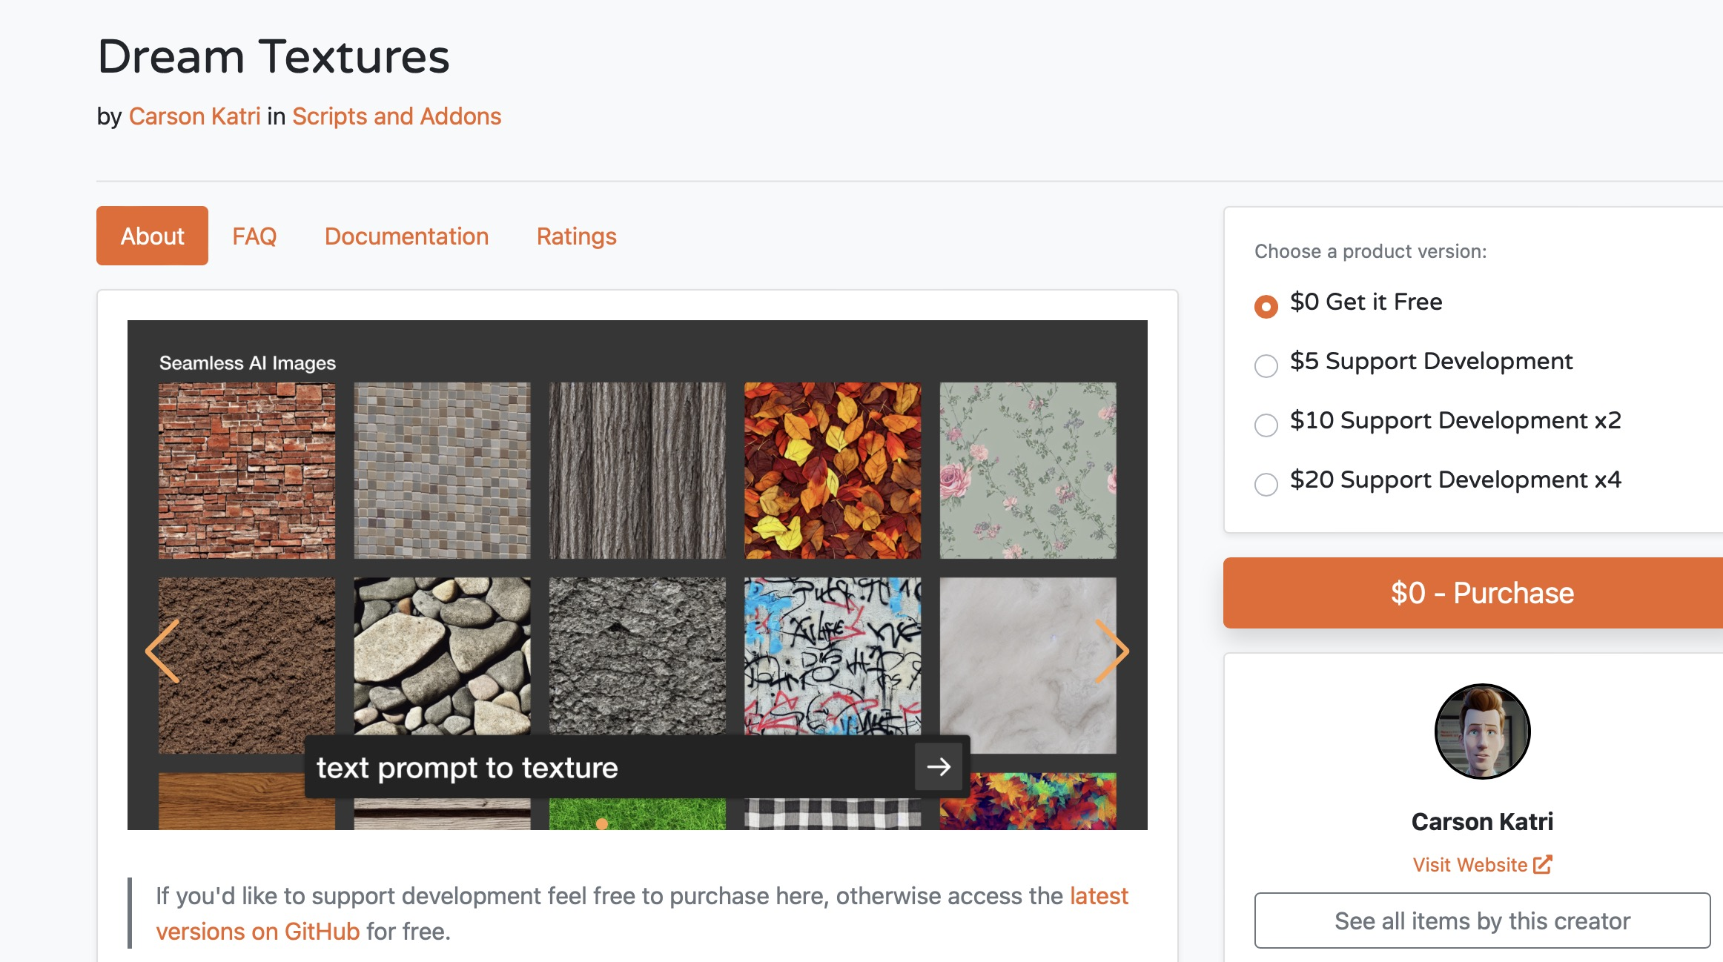
Related Work – Dream Textures
Developed by Carson Katri
Plugin for Blender
Generates unique images for models using Stable Diffusion
Hosted locally
Texture Projection
Upscaling
Free
Only for Blender

Slide 9
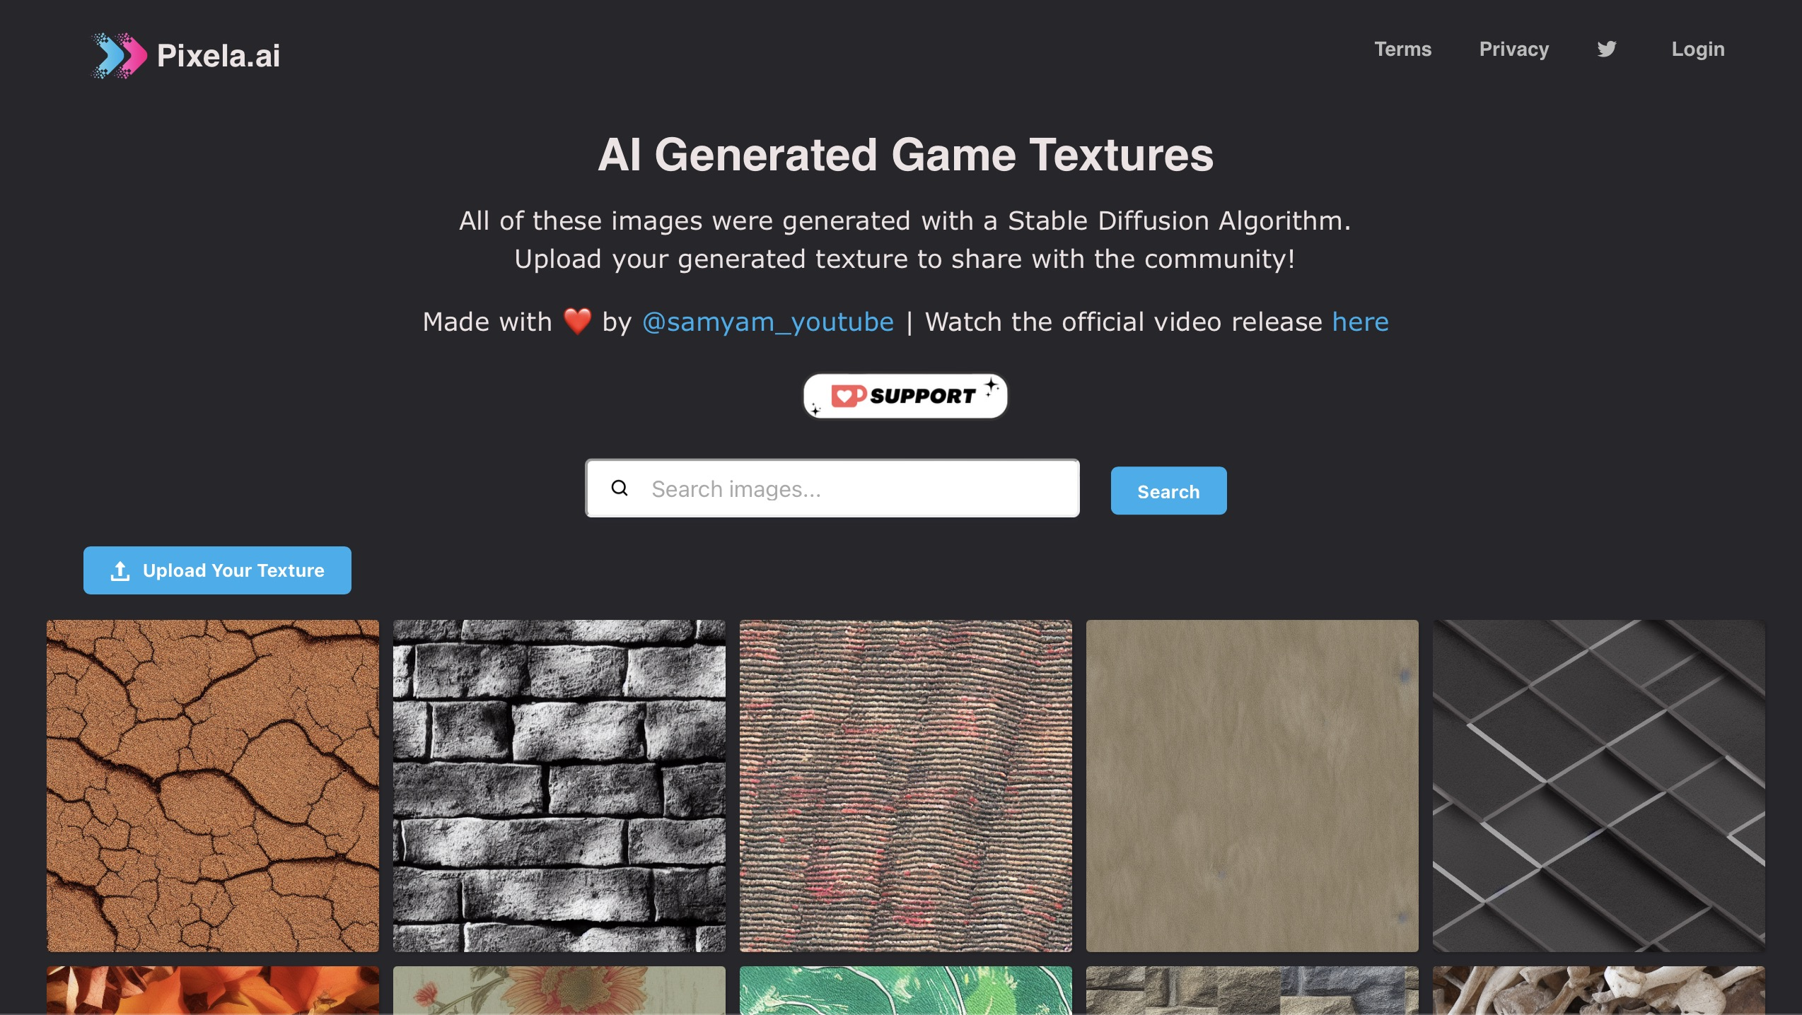
Related Work – Pixela.ai
Developed by Samyam
Online repository for AI textures
Search bar
Favourites
‘New Random Textures’
Free
Can only be used outside Unity
Not editable

Slide 10
Motivation
Looking online for textures is frustrating
Allow Unity users to acquire textures without leaving the application
Faster workflow
Simpler for beginners

Slide 11
Aims & Objectives
Create functioning plugin
Simple UI window
Send requests to local build of Stable Diffusion
Generate images in Unity without needing to leave the window
Parameters to control plugin output
Import images to assets

Slide 12
Design - Requirements
Baseline requirements or the project to be successful:
Allow the user to send a text-input prompt to a local build of Stable Diffusion
Allow the user to generate AI textures without the need to leave the Unity application
Allow the user to alter the Stable Diffusion seed
Allow the user to alter the Stable Diffusion steps
Allow the user to import the generated images into their Unity Assets

Slide 13
Design – Potential Features
The following would improve the plugin but are not necessary to the objective:
Allow the user to toggle seamless textures
Allow for the editing of an initial image by Stable Diffusion to produce alterations to the original
Allow the user to alter size of the textures
Remember previously generated textures
Include advanced editing tools after generation
Include an online database for community sharing of textures
Allow for the altering of the Img2Img strength
Allow the user to change the number of images generated
Allow the user to change the sampling method
Include a PBR texture generator
Include a ’Texture Projection’ function
Include an upscaling feature

Slide 14
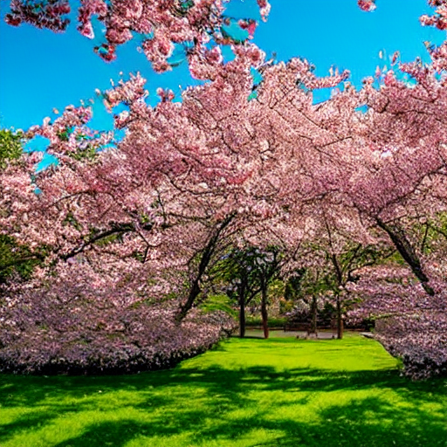
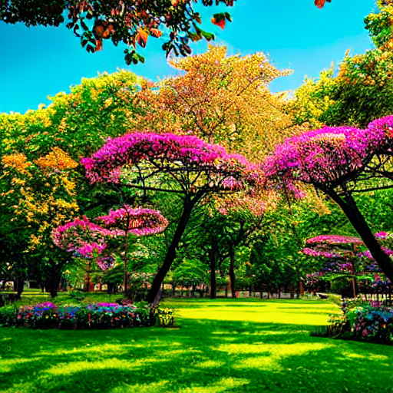
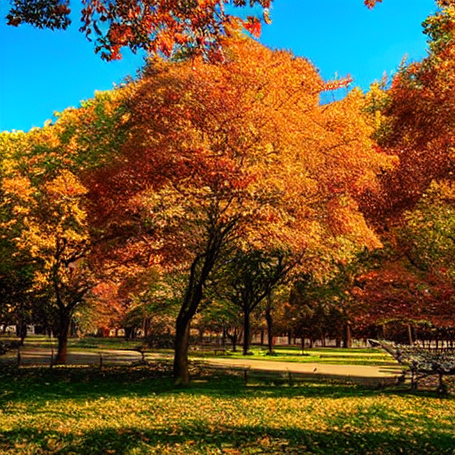
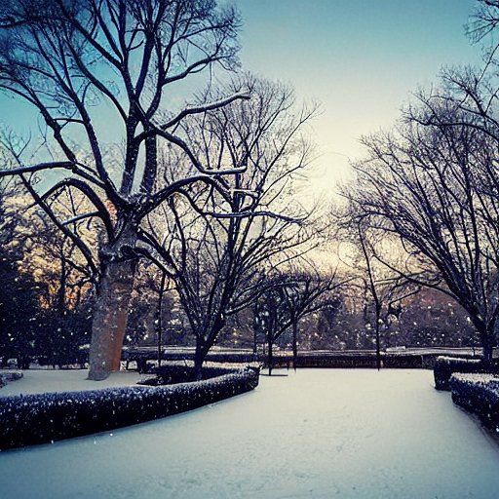
Parameter – Seed
Generates the initial noise Stable Diffusion uses to create the new image
Can be set to any number
The same seed will generate the same image (if the other parameters are unchanged)
Can allow for slight variations in output image
Set to -1 by default (random seed)
beautiful park, spring
beautiful park, summer
beautiful park, autumn
beautiful park, winter
Seed: 500

Slide 15
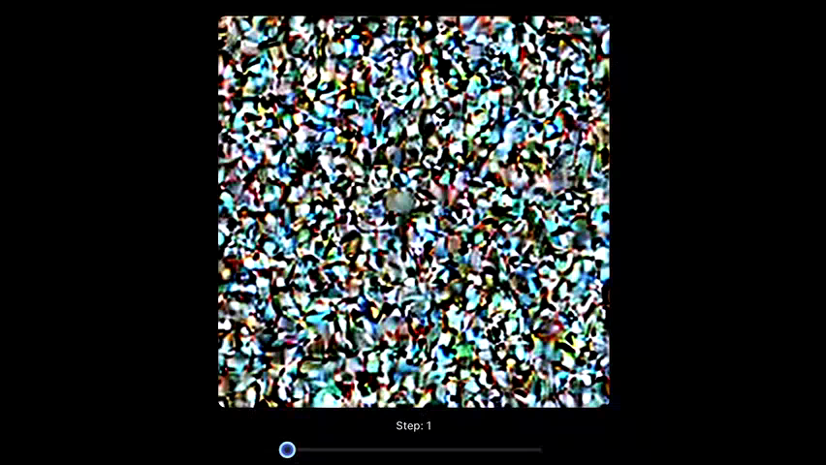
Parameter – Steps
Defines the number of times Stable Diffusion iterates its algorithm
The more steps the clearer and more accurate the image
Higher steps higher performance cost
(video)

Slide 16
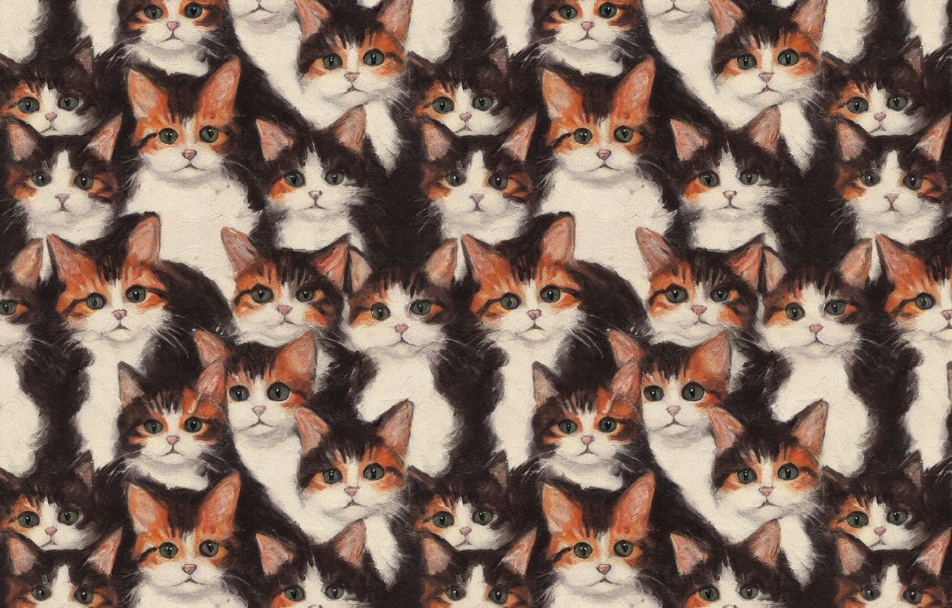
Parameter – Seamless
A toggle option
When enabled will rearrange the edges of the generated image so it gives the appearance of continuity between opposite edges
Useful for larger objects (sky, ground)

Slide 17
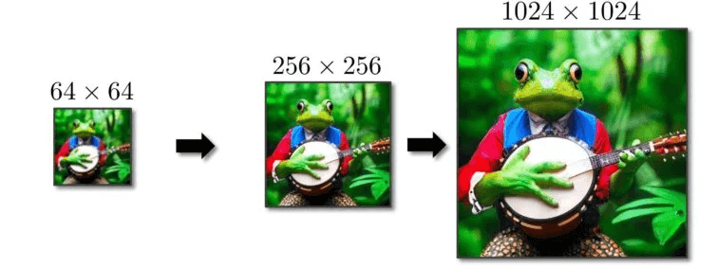
Parameter – Size
Determines the size of the output image
5 options to choose (pixels):
64x64
128x128
256x256
512x512
1024x1024
Larger the image higher the performance cost

Slide 18
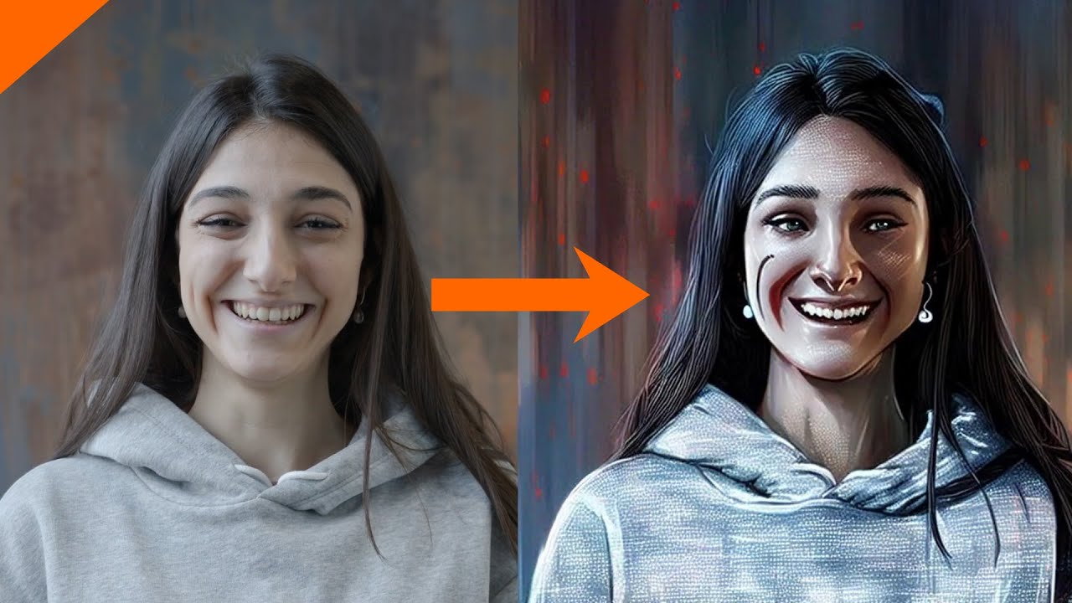
Parameter – Img2Img
Used when initial image is used
Slider controlling blending of additional generated textures to initial image

Slide 19
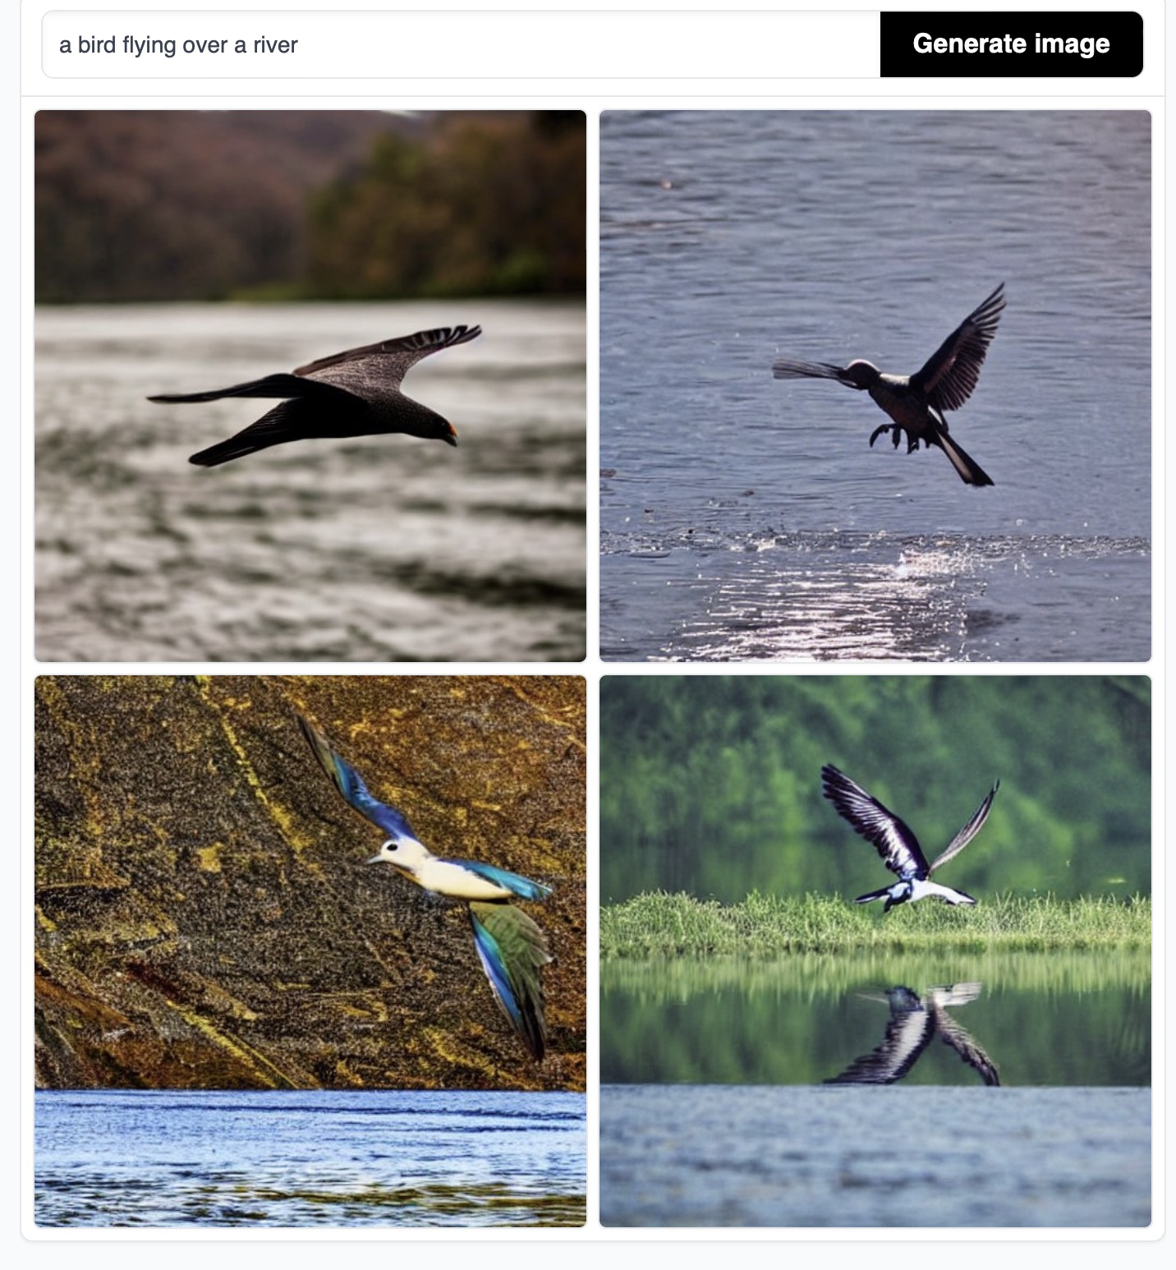
Parameter – Image No.
Controls how many output images to request from Stable Diffusion
If image number is 4 will generate 4 randomly seeded images
Higher number higher performance cost

Slide 20
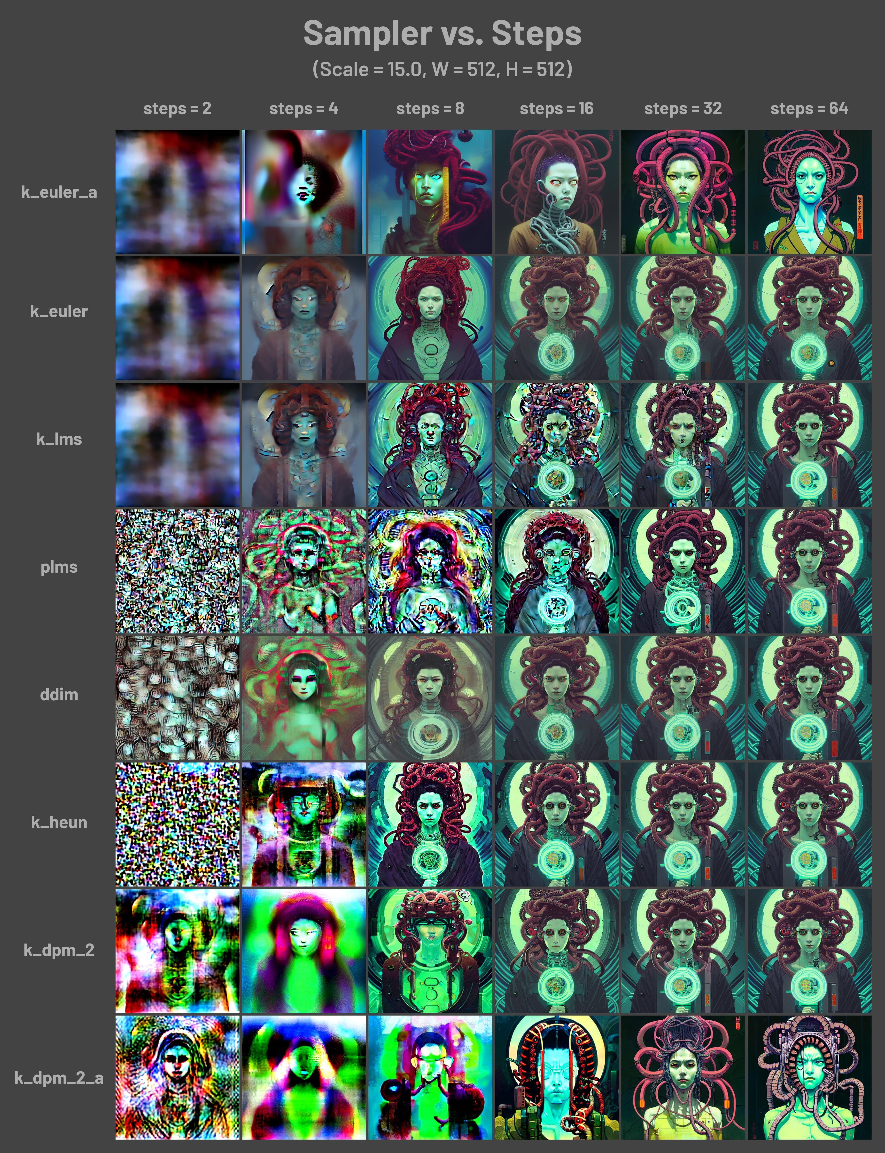
Parameter – Sampling Method
Sampling methods change how Stable Diffusion handles its sample data
Parameter informs Stable Diffusion which sampling method to use
Some increase precision at cost of performance
Some increase processing speeds at cost of quality
Some give unique styles

Slide 21
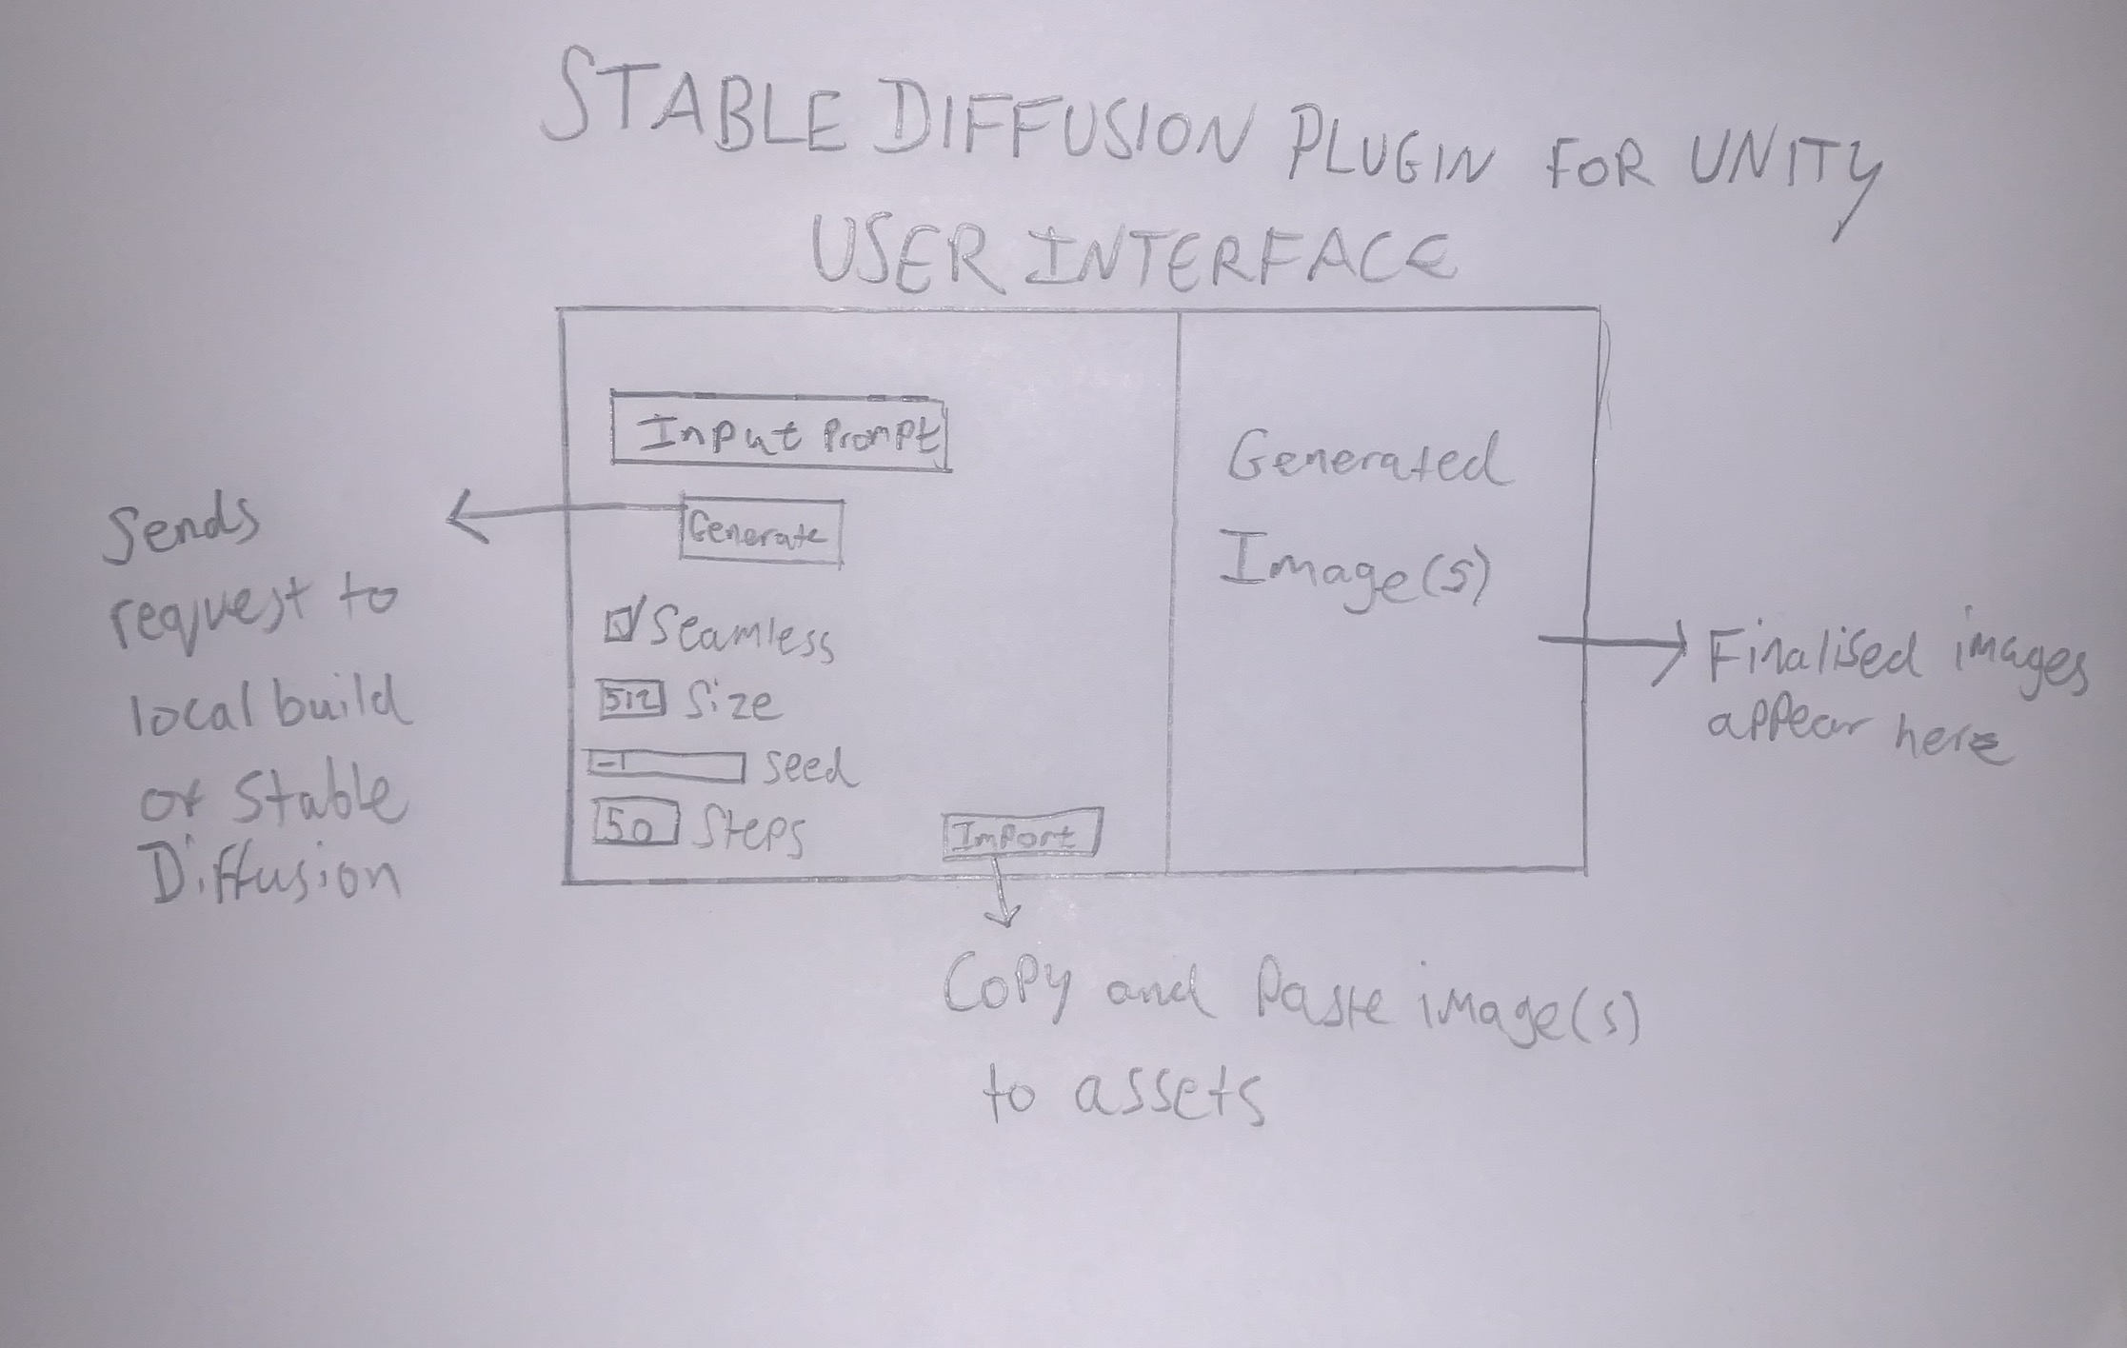
Initial UI Design

Slide 22
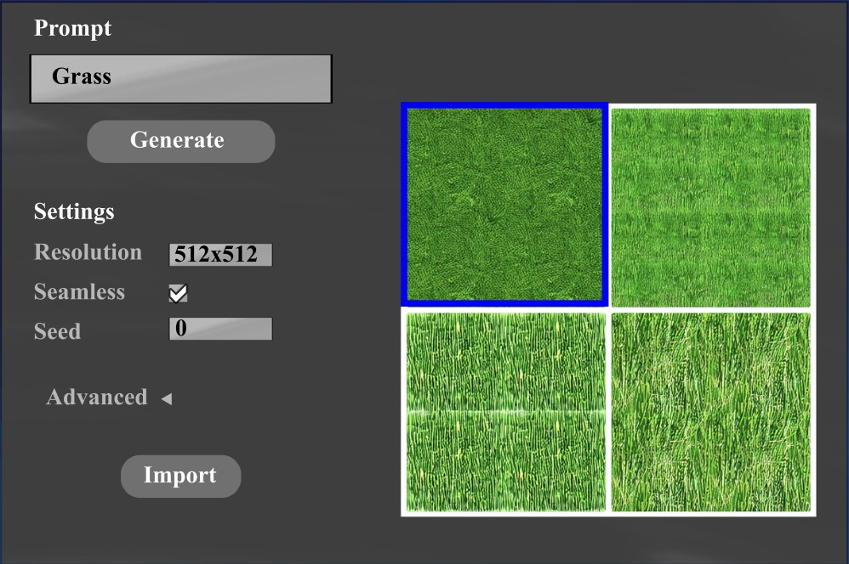
Computer UI Design

Slide 23

Running Stable Diffusion Locally
Using InvokeAI
Web functionality – LocalHost
Unity C# – Built in HTTP POST function

Slide 24
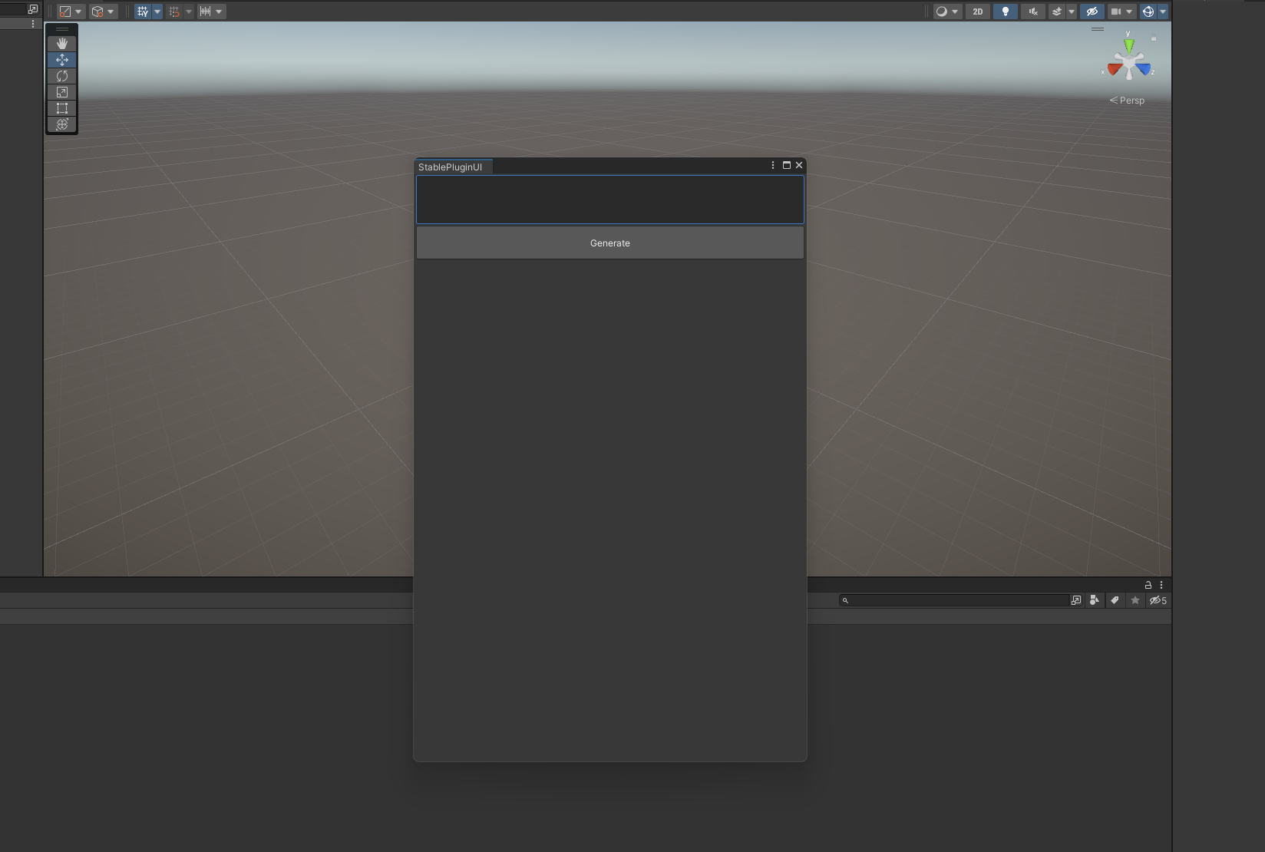
Prototype
Functioning example of plugin window
Sends Debug.Log() instead of HTTP POST for now
Vertical window

Slide 25

Implementation
Final implementation using Visual Studio 2022 and C#
Built in Unity environment

Slide 26
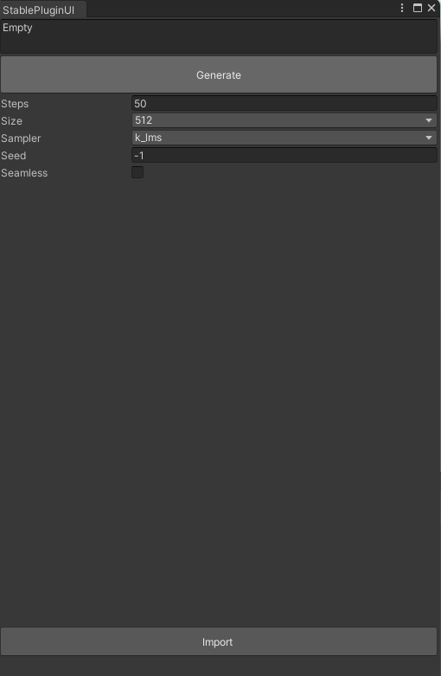
Final UI Design
Built mostly using Unity’s EditorGUILayout class
Can be accessed via Tools/StablePluginUI
Input box
Generate button
Steps – default 50
Size – default 512x512
Sampling method – default k_lms
Seed – default -1
Seamless – default disabled
Import button

Slide 27
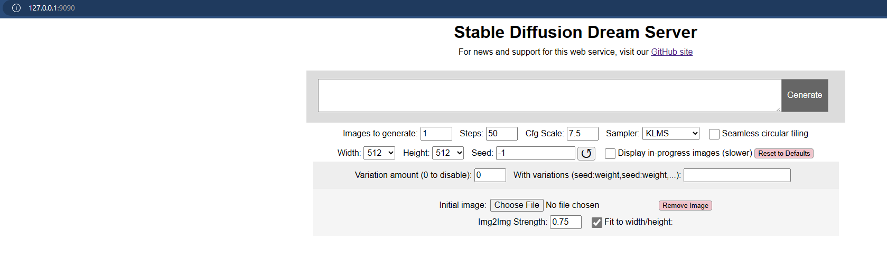
Stable Diffusion on LocalHost
InvokeAI
7GB model package
Anaconda

Slide 28
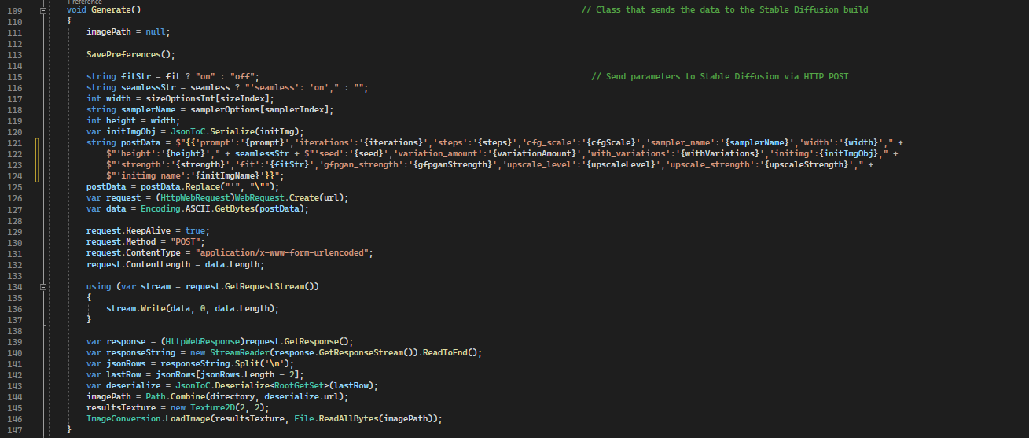
StablePluginUI Script - Generate
Generate() function:

Slide 29
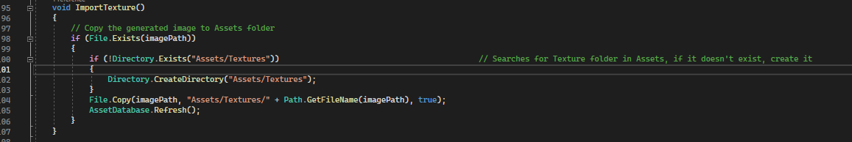
StablePluginUI Script - Import
ImportTexture() function:

Slide 30
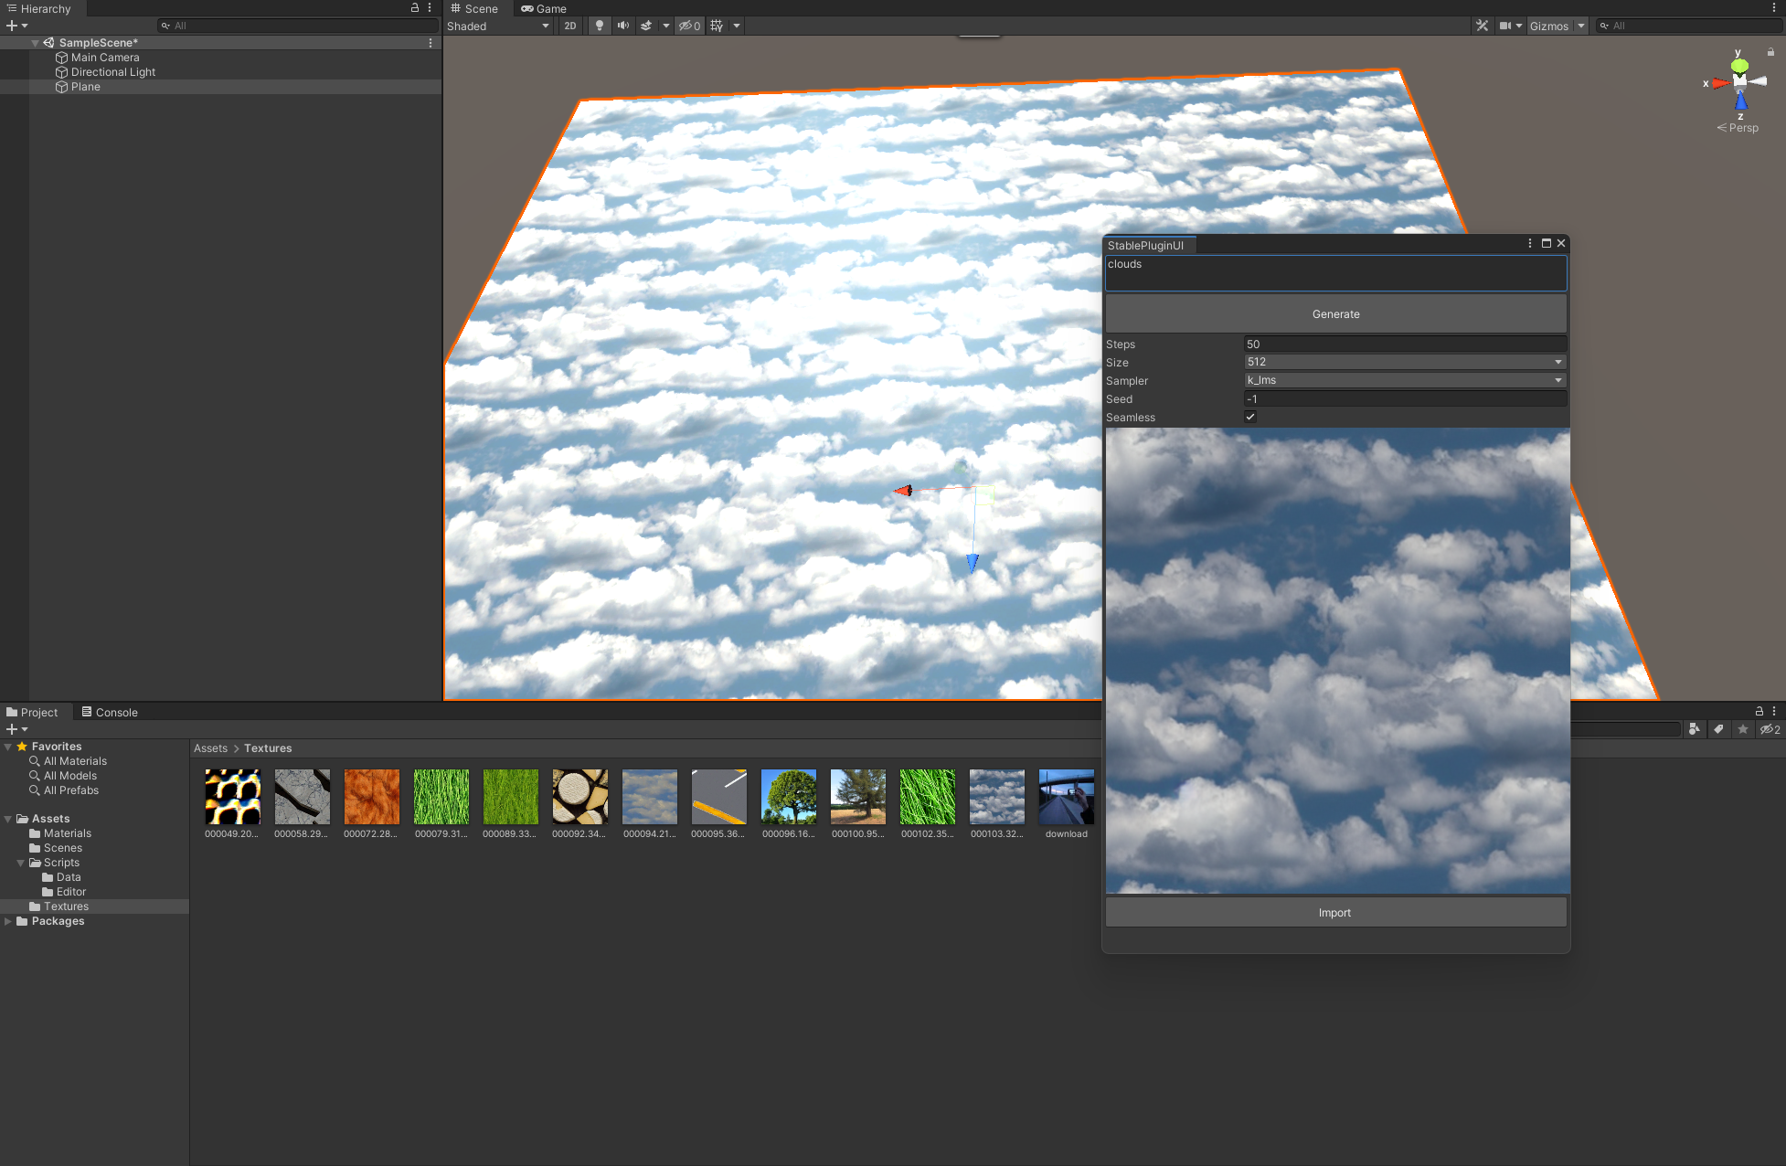
Results
Seamless texture example:
Parameters:
Steps: 50
Size: 512x512
Sampling method: k_lms
Seed: -1
Seamless: Enabled

Slide 31
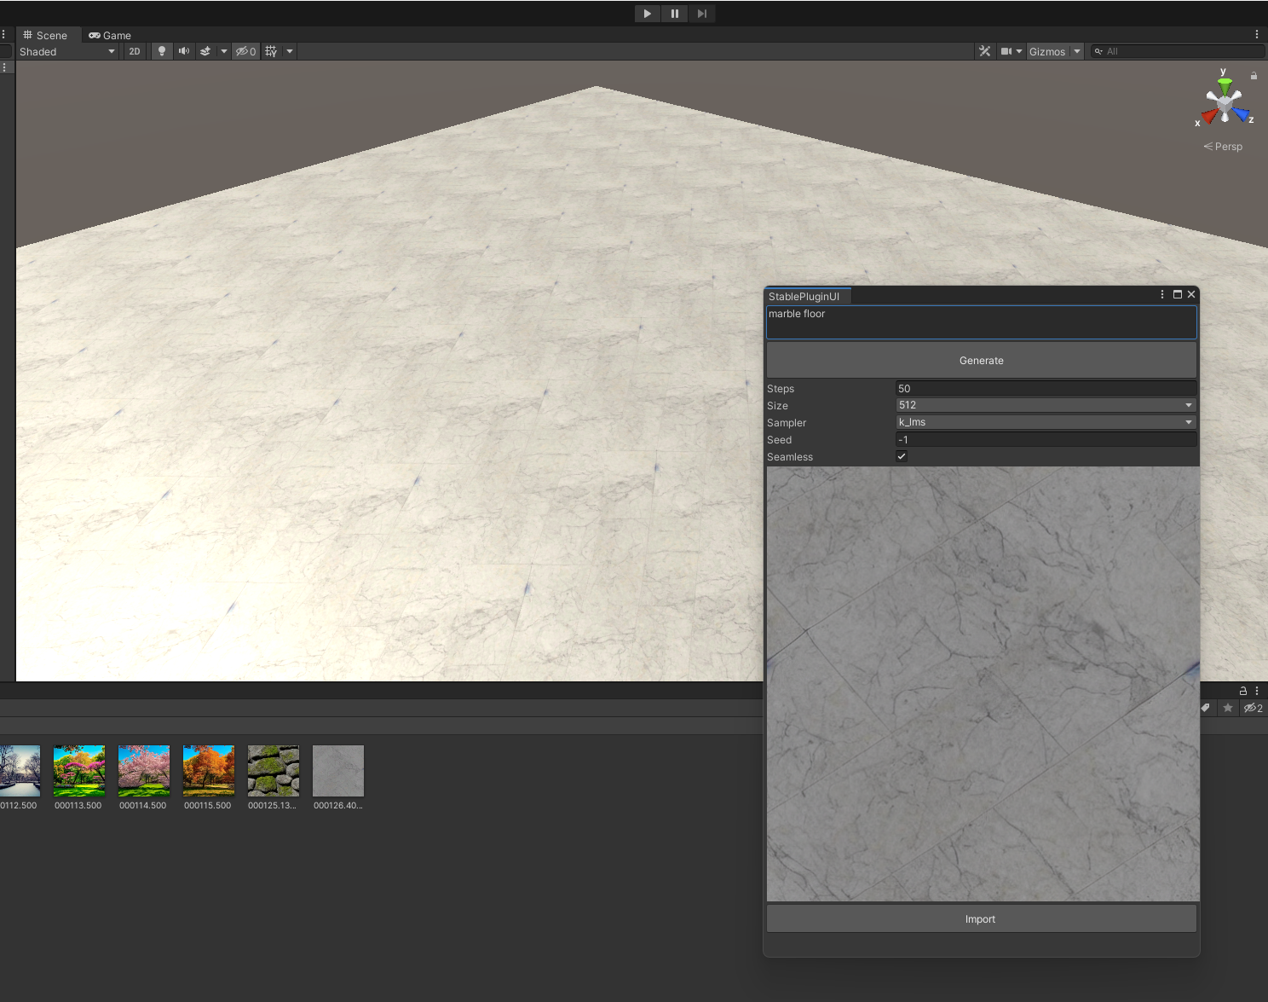
Evaluation
Tested by a friend
User was mostly pleased with functionality – does what its supposed to do
Easy to use
Missing full list of parameters
Can only generate simple 2D textures

Slide 32
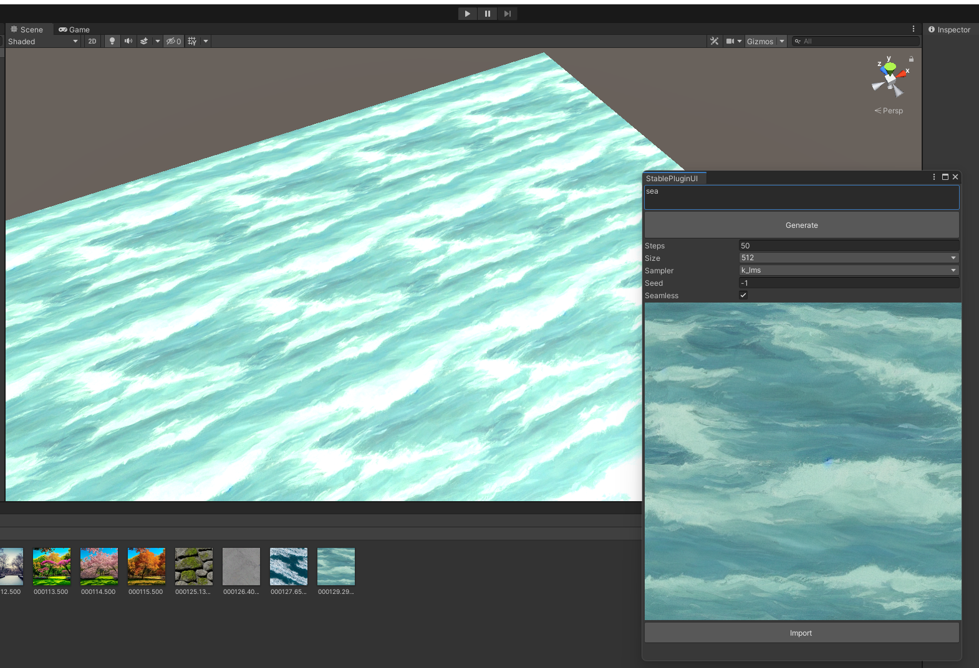
Conclusion
Project success
Fully functional
Effective and efficient texture generator
Easy to use
Lacks full parameters
Only generators standard 2D images

Slide 33
Future Work
Full parameter inclusion
PBR
Online Repository
Texture Mapping
Upscaling

Slide 34
Acknowledgements
Thanks to:
InvokeAI
Hugging Face
Anaconda
https://www.invoke.ai
https://huggingface.co/CompVis/stable-diffusion-v-1-4-original
https://docs.anaconda.com/free/anaconda/install/windows/

